Slide 1
Planar Graphs
Hubert Chan (Chapter 9.7)
[O2 Proof Techniques]
[O3 Basic Analysis Techniques]

Slide 2
Motivation: Planar Layouts
Printed Circuit Boards:
Can we connect the three pins in chip A to three pins in chip B without crossing the wires?
A
B
Puzzle:
Three houses have to connect to three utilities, Electricity, Water and Gas. Houses and Utilities can be treated as vertices and built anywhere.
W
E
G

Slide 3
Planar Graphs
A graph is planar if it can be drawn in the plane without any edge crossings.
  Is K₄ planar?
  Is Q₃ planar?
  Is K_{3,3} planar?

Slide 4
Planar Graphs
d
a
b
e
a
b
c
c
g
f
g
f
h
h
i
d
i
g
e
c
a
b
f
e
i
d
h

Slide 5
Formula for Planar Graphs
A planar drawing of a planar graph divides the plane into a number of regions
Example 1: Triangle
v = 3, e = 3, r = 2
Example 2: Square
v = 4, e = 4, r = 2
How about fix v and increase e,
see how r is affected?
Example 3: Tetrahedron
v = 4, e = 6, r = 4
How about we fix e and increase v,
how r is affected?
Example 4: Cycle C₆
v = 6, e = 6, r = 2
Note: the number is not affected by the drawing!
What is the formula?

Slide 6
Euler’s Formula for Planar Graphs
Euler’s Formula for connected planar simple graph with v vertices, e edges and r regions
r = e – v + 2
Hypercube Q3
v = 8, e = 12, r = 6
(r+v=e+2)
R₁
R₂
R₃
R₄
R₆
R₅
single edge
v = 2, e = 1, r = 1
single vertex
v = 1, e = 0, r = 1
multigraph (in fact, it applies to multigraph too)
v = 3, e = 3, r = 2
How to prove?
Also to single loop: v = 1, e = 1, r = 2

Slide 7
Euler’s Formula for Connected Planar Graphs
r = e – v + 2. Induction on which parameter?

Slide 8
Examples
Q: Suppose that a connected planar simple graph 20 vertices, each of degree 3. Intro how many regions does a representation of this planar graph split the plane?
v = 20, e = 3 x 20/2 = 30
=> r = e – v + 2 = 30 – 20 + 2 = 12.
Q: In a connected planar simple graph, if each region is bounded by at least 3 edges, there are 10 regions, what is the minimum number of edges?
Each edge touches 2 regions. If we put two “x” for each edge, one of each of these regions (see the figure), then each region has at least 3 “x”s.
There are e edges, so # of x’s = 2e
There are r regions, # of x’s ≥ 3r.
So, 2e ≥ 3r, r = 10, so e ≥ 15.
x
x
x
x
x
x
x
x
x
x
x
x
The number of x in a region r is called the degree of r.

Slide 9
Relationship between r and e
If we add all degrees of all regions, the sum will be equal to 2e.
Recall also that the relationship between the number of vertices, degree of the vertices, and the number of edges.
[Sum of degrees of all vertices = 2e.]
e.g. If there are 5 vertices, the degree of each vertex is at least 3, what is the minimum number of edges?
The total sum of all degrees = 2e.
So, 2e ≥ 3v
v = 5, so e ≥ 8.
Note: Each region is bounded by at least 3 edges!

Slide 10
Inequality for Planar Graphs
If G is a connected planar simple graph, with e edges and v ≥ 3 vertices, then e ≤ 3v – 6.
(Intuitively it says that there cannot be too many edges)
A planar graph of v vertices has almost 3v – 6 edges, i.e., all planar graphs are sparse graphs
Proof: The degree of a region deg(R) = number of edges on the boundary of this region (= number of x’s inside the region)
    Example:
    deg(R₃) = 3
    deg(R₁) = 5
    deg(R₂) = 6
R₁
R₂
R₃

Slide 11
Relationship between v and e [O3]
R₁
x
x
  We have
  2e = ∑_{all region R} deg(R)
  = deg(R₁) + deg(R₂) + deg(R₃)
    = 14, i.e., e = 7
  As deg(R) ≥ 3 (=3 when R is a triangle)
  2e = ∑_{all region R} deg(R) ≥ 3r, i.e., r ≤ 2e/3
  Since r = e – v + 2, we have e – v + 2 ≤ 2e/3.
  Thus e ≤ 3v – 6
x
x
x
x
R₂
x
x
x
x
R₃
x
x
x
x

Slide 12
Is K₅ planar?
Planar graphs ⇒ e ≤ 3v – 6
That is, planar graphs cannot have too many edges.
Example 1: Is K₅ planar?
For K₅ , v = 5, e = 10,
3v – 6 = 9 < e,
Hence K₅ cannot be planar
K₅

Slide 13
Is this bound, e ≤ 3v – 6, tight? [O3]
Are there any graphs of v vertices having exactly 3v – 6 edges?
Yes, as long as all regions are triangles.
v = e = 3
v=4, e=6
v=5, e=9
v=6, e=12
Corollary: A planar graph must have a vertex of degree ≤ 5.
Proof: By contradiction.
Assume all vertices are of degree 6 or above.
Thus, sum of degrees = 2e ≥ 6v, or e ≥ 3v.

Slide 14
Summary: If e > 3v – 6, then G is NOT a planar graph.
However, converse might not true, that is, if e ≤ 3v – 6, we cannot conclude if G is planar or not.
We might have a non-planar graph satisfying e ≤ 3v – 6.
See the example in the next slide.

Slide 15
Planar Bipartite Graph [O2]
For K_{3,3}
v = 6, e = 9, 3v – 6 = 12 > e
This does NOT mean K_{3,3} is planar!
Claim: Any simple triangle-free
planar graph with e edges and v vertices
satisfies e ≤ 2v – 4.
Proof: As any region in a bipartite graph is bounded by at least 4 edges, i.e, deg(R) ≥ 4
So we have 2e = ∑_{all region R} deg(R) ≥ 4r , i.e., e/2 ≥ r
From Euler formula
e/2 ≥ r = e – v + 2
v ≥ e/2 + 2 or e ≤ 2v – 4
a
d
b
e
c
f
K_{3,3}

Slide 16
Is K_{3,3} planar?
Since K_{3,3} is a bipartite graph, and
if K_{3,3} is also a planar graph, then it
should not have too many edges,
i.e., we should have e ≤ 2v – 4
With v = 6, a planar bipartite should have at most e = 2v – 4 = 8 edges.
Since K_{3,3} has 9 edges, K_{3,3} can’t be planar.
a
d
b
e
c
f
K_{3,3}

Slide 17
Summary: Euler’s Formula for Planar Graphs
Euler’s Formula for connected planar graph with v vertices, e edges and r regions
r = e – v + 2
Any simple connected planar graphs (without multiple edges nor self-loops) of v vertices have
at most e ≤ 3v – 6 edges
(e ≤ 2v – 4 edges if the graph is triangle-free).
A simple connected planar graph must have (exists)
a vertex of degree ≤ 5.
The complete graph K₅ is not planar.
The complete bipartite graph K_{3,3} is not planar.

Slide 18
Coloring(Chapter 9.8) : Map Coloring
Given a map, try to color every region of the map such that adjacent regions have different colors.
Can we color the map with
the least number of
colors?
Four Color Problem
All maps can be colored with
no more than four colors.

Slide 19
Proper Coloring
Map coloring – color the regions of a map such that no two adjacent regions are of the same color
Graph coloring (vertex)– color the vertices of the graph such that no two adjacent vertices are with the same color
Edge coloring – color the edge of a graph such that no two adjacent edges are of the same color

Slide 20
Map Coloring and Graph Coloring
Map coloring
Graph coloring
Model this as a graph coloring problem:
  Vertex – region
  Edge – connects regions that share borders
  Coloring – assignment of colors to vertices so that
  no two adjacent vertices are assigned the same color

Slide 21
Edge Coloring and Graph Coloring
Edge coloring can also be reduced to graph coloring
vertex corresponds to every edge of the original graph
edge between two vertices when the corresponding edges are incident with the same vertex in the original graph.
a
d
a
d
c
c
f
f
b
e
b
e
Graph coloring should be the most general problem.

Slide 22
How Many Colors?
Some graphs require fewer colors
Non-planar graphs may require more than 4 colors
Example: How many colors are required?
C₆
K₆
K_{3,4}
Chromatic number of a graph is the least number of colors needed for coloring a graph.
For example:
Chromatic number of C₆ = 2
Chromatic number of C₅ = 3
Chromatic number of K₆ = 6
Chromatic number of K_{3,4} = 2
Note: for bipartite graph, chromatic number = 2.

Slide 23
Chromatic Number [O2]
Theorem: If the maximum degree of the vertices in a graph is k, then the chromatic number of the graph is at most k+1.
Proof: By coloring each vertex one by one.
Since each vertex is adjacent to at most k vertices ,
i.e., each vertex is adjacent to at most k colors.
Thus we can always color that vertex by one of the remaining colors, so k+1 colors will be needed.
Example:
Max degree = 4
At most 5 colors
3
4
3
1
2
3
5
2
2
2
1
1
1
3

Slide 24
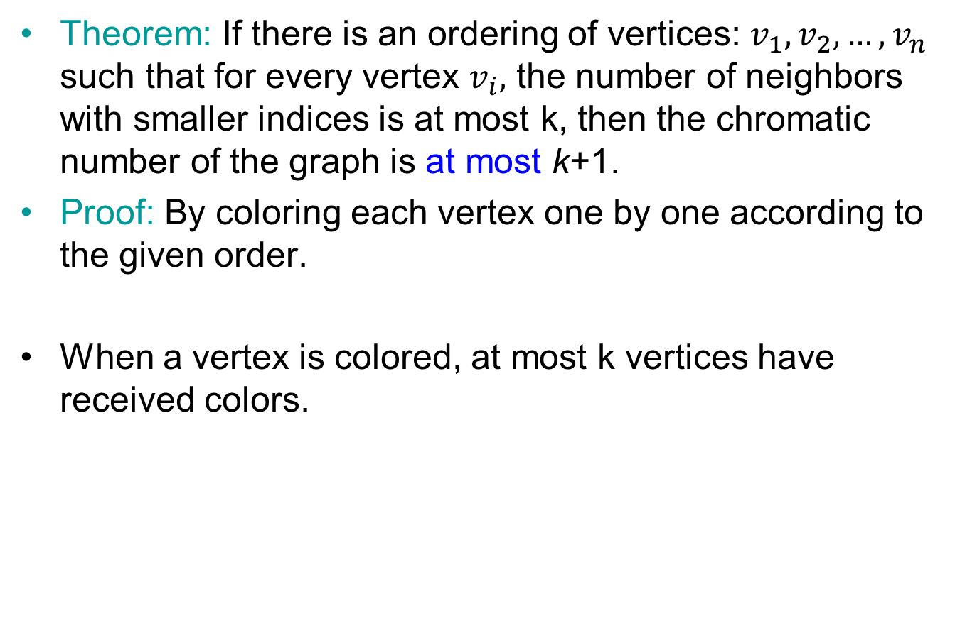
More General Theorem[O2]
Theorem: If there is an ordering of vertices: $v_{1}, v_{2},…, v_{n}$ such that for every vertex $v_{i},$ the number of neighbors with smaller indices is at most k, then the chromatic number of the graph is at most k+1.
Proof: By coloring each vertex one by one according to the given order.
When a vertex is colored, at most k vertices have received colors.

Slide 25
Applications
Scheduling final exams: 7 finals (1 – 7), the following exams have common students: 1 and 2; 1 and 3; 1 and 4; 1 and 7; 2 and 3; 2 and 4; 2 and 5; 2 and 7; 3 and 4; 3 and 6; 3 and 7; 4 and 5; 4 and 6; 5 and 6; 5 and 7; 6 and 7. What is the minimum number of time slots needed to schedule all exams?
K₄
1
Vertex: Exam
Edge between two exams: if they have common students
To find chromatic number?
7
2
6
3
We got a K4 as a subgraph, so 4 colors will be needed, it turns out 4 colors are sufficient.
5
4
Remark: finding the chromatic number of an arbitrary graph is difficult.

Slide 26
Radio Frequencies
Two stations can not use the same channel frequency when they are within 150 miles of each other.
How many different frequencies needed for the 6 stations?
F
 | A | B | C | D | E | F
A | - | 25 | 202 | 77 | 375 | 106
B | 25 | - | 175 | 51 | 148 | 222
C | 202 | 175 | - | 111 | 365 | 411
D | 77 | 51 | 111 | - | 78 | 297
E | 375 | 148 | 365 | 78 | - | 227
F | 106 | 222 | 411 | 297 | 227 | -
A
B
3 frequencies
Same frequency
for Stations
  A & E
  D & F
  C & B
D
E
C
V = radio stations; E = two stations within 150 miles
Number of colors = number of different frequencies.

Slide 27
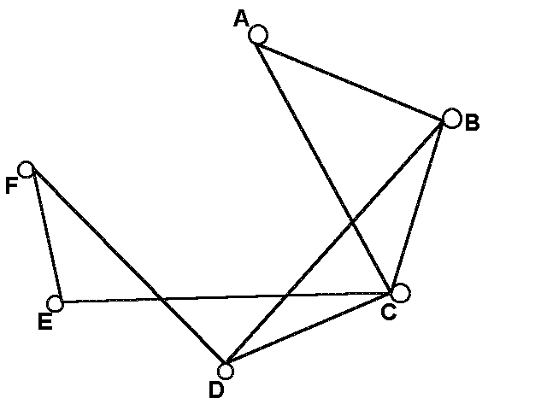
Fishes Tanks
Six different types of fish: A, B, C, D, E, and F.
Because of predator-prey relationships, water conditions, and size, some fish cannot be kept in the same tank.
How many fish tanks are needed?
V = types of fishes
E = fishes that cannot be in the same tank
Different colors = different tanks
Type | A | B | C | D | E | F
Cannot be with | B, C | A ,C, E | A, B, D, E | C, F | B, C, F | D, E
Tank 1 | Tank 2 | Tank 3
A, D, E | F and C | B

Slide 28
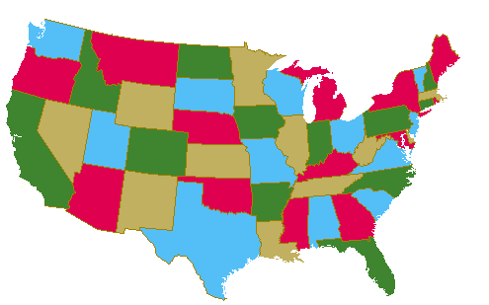
Remark
The Four Color Theorem: Any planar graph can be colored using at most 4 colors. (i.e., chromatic number of a planar graph is 4).
1850: Conjectured by Guthrie (a University College student).
1852: De Morgan told Sir WR Hamilton
1879: Published “proof” by Kempe
1890: Refutation of Kempe proof by Heawood
  Proof did prove 5-color theorem
1976: Proof by Appel and Haken (University of Illinois)
  Reduced to about 2000 different configurations.
  Proved correct in 1976 by a computer program
  Required hundreds of hours of computer calculations

